Slide 1
Retail Giant Sales Forecasting - Case Study

Slide 2
Agenda :
Objective
Background
Analysis & Key findings:
Data Understanding
Finding Most Consistently High Profitable Market Segment
Finding the Most Reliable Time Series Model
Conclusion
Recommendations
Appendix:
Data Sources
Data Assumption
Data Preparation
Data Methodology

Slide 3
Objective :
Find out the Most Profitable and Consistent Market Segment for the company.
Forecast the Sales and the Demand for the next 6 months for the Most Profitable and Consistent Market Segment

Slide 4
Background – Time Series Case Study :
Global Mart, an online store super giant having worldwide operations, takes orders and delivers across the globe dealing with all the major product categories (consumer, corporate & home office)
The store wants to finalize the inventory management plan for the next 6 months to ensure least loss (wastage by high production) and realise high revenue by meeting the right demand at its specific time (by planning, managing inventory and producing at right amount well in advance to meet the demand at its specific time)

Slide 5
Analysis :
The analysis has been divided into following parts:
Data Understanding
Finding Most Consistently High Profitable Market Segment
Finding the Most Reliable Time Series Model

Slide 6
Data Understanding – Major Attributes
Original Dataset contain 51290 Rows and 5 Columns transactions from 2011 – 2014
Attribute | Description
Order Date | Date on which the orders were placed
Segment | The market segment to which the customer belongs
Market | Geographical market sector to which the customer belongs
Sales | Total sales value of the transaction
Profit | Profit made on the transaction

Slide 7
Data Understanding – Segmentation of Data
The “Market” attribute has 7-factor levels representing the geographical market sector that the customer belongs to
Also, the “Segment” attribute tells which of the 3 segments that customer belongs to
Market
Africa
APAC (Asia Pacific)
Canada
EMEA (Middle East)
EU (European Union)
LATAM (Latin America)
US (United States)
Segment
Consumer
Corporate
Home Office

Slide 8

Data Understanding – Major Attributes (After Transformation)
Post Concatenating the Column, Market and Segment, and Aggregating the total values of profit for 21 market segments by its ordered month and year through pivot table, The data we received for the analysis had 21 attributes
Hyper-Link: To have a look over the Transformed Dataset:
Note: We are assuming all transactions in Standard US Dollar only

Slide 9
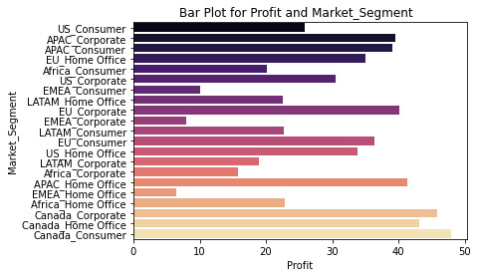
Finding the Most Profitable Market Segment
Based on the analysis, the top five most profitable market segments worldwide are :
Rank 1: Canada_Consumer
Rank 2: Canada_Corporate
Rank 3: Canada_Home Office
Rank 4: APAC_Corporate
Rank 5: APAC_Consumer

Slide 10
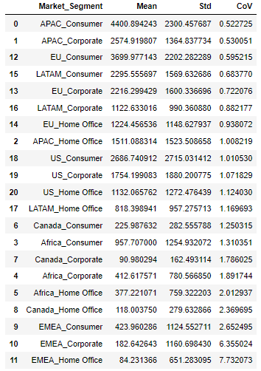
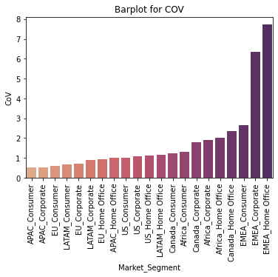
Finding the Most Consistent Market Segment w.r.t. Profit
Cov - The coefficient of variation (standard deviation/mean) was used to find the Most Consistently Profitable Segment.
The segments with the lowest COV are APAC Consumer and APAC Corporate
This means that these segments have the lowest amount of variation, and hence are the most predictable ones

Slide 11
Selecting the Most Consistently Profitable Market Segment
We found APAC Consumer as Top 5th Highly Profitable Market Segment, and at the same time, this to be having least CoV value (0.522725)
Thus, APAC Consumer is the Good Market Segment to be relied upon for further Sales Forecast

Slide 12
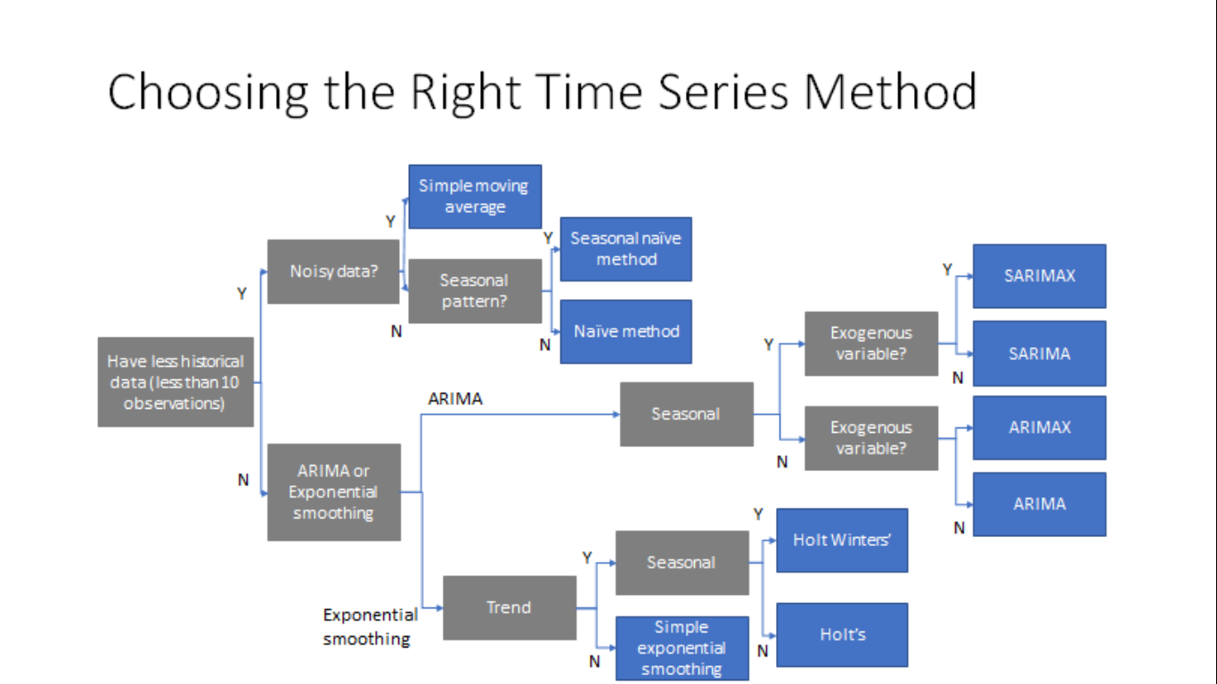
Flow-Chart for the Time Series Model

Slide 13

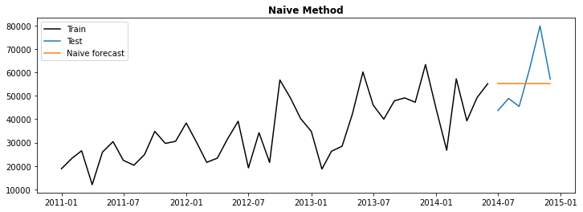
Naïve Time Series Model (NM)
The chart displays the predicted values based on the previous month's data
It’s only the level that it can predict (that too based on the last predicted value)
Straight line can been in the graph (for the forecasted curve) as its basis is only the last value that we had in the dataset, later when no new data was available for future months we could not any change w.r.t. to future time
Note: Naïve Method better used when data points <10 and no noise and seasonality present in the dataset

Slide 14

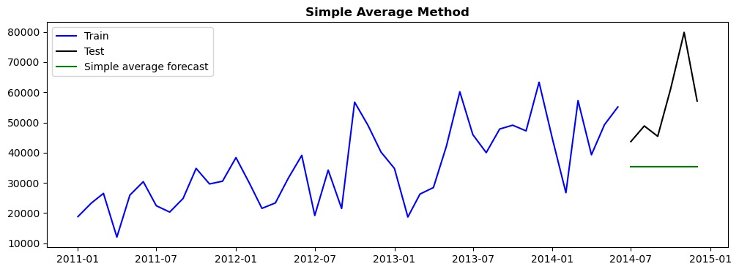
Simple Average Time Series Model (SA)
Although the train and test datasets exhibited both trend and seasonality, the projected green line does not display any trend and seasonality
Seasonality & Trend could not be predicted: Reason: Averaging out the whole data set: so practically De- Seasonalising & De- Trending the whole dataset
Note: SA works better with less than 10 data points and when observations are noisy

Slide 15

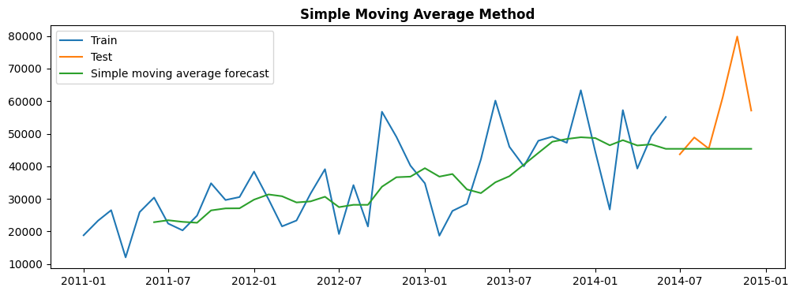
Simple Moving Average Time Series Model (SMA)
In the case of the 6-month window, both the train and test datasets showed trends and seasonal patterns, but the forecasted curve can only track the level & trend, but trend is tracked only for the training dataset only, not for test data set
Note: SMA works better with longer duration rolling window and aimed to predict the trend better when the data is less (<!0 data points) and is noisy. It eliminates the fluctuations & noise by averaging them out over a rolling period of time

Slide 16

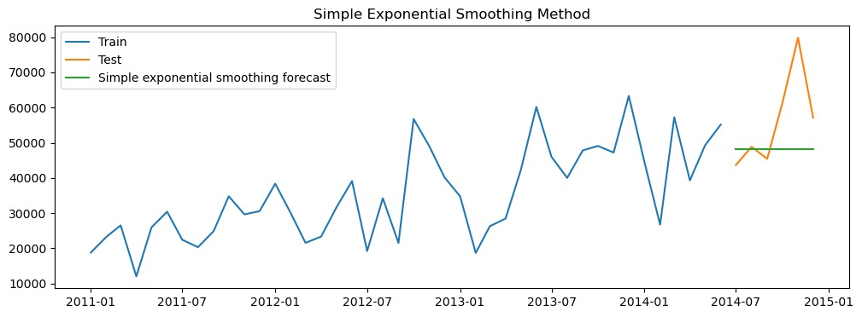
Simple Exponential Smoothing Time Series Model (SES)
It is evident from the orange and blue lines in the data that there is a pattern of trend and seasonality. The green line represents the forecasted level, indicating that this particular model is capable of identifying only the level, which is expected to remain constant at around 40k to 50k between 2014 and 2015
Note: SES works better with large data points (>10) and aimed to predict only the level

Slide 17

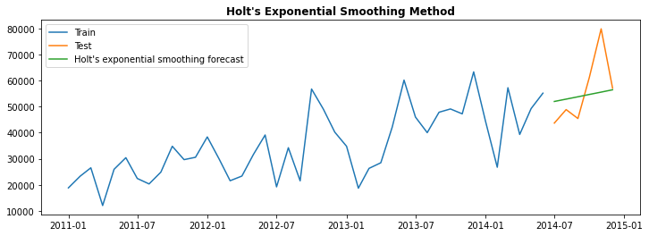
Holt’s Exponential Smoothing Time Series Model (HES)
The test data is represented by the blue line, while the orange line represents the training data. The green line shows the forecasted trend and level of the data, which is seen to follow the pattern observed in the time period of approximately 2014 to 2015
Note: HES works better with large data points (>10) and aimed to predict both the level and trend

Slide 18

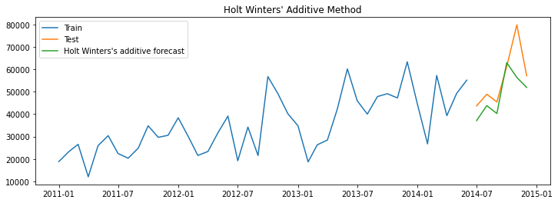
Holt’s Winter Additive Time Series Model (HWA)
The blue and orange lines in this graph indicate the training and test data, respectively. The green line represents the seasonality, trend, and level of the data, which is observed to be around the time period of approximately 2014 to 2015
This model seems to be predicting better but somewhat under predicting as do not reaches the actual peak
Note: HWA works better with large data points (>10) and aimed to predict all the 3 components i.e. level, trend, and seasonality

Slide 19

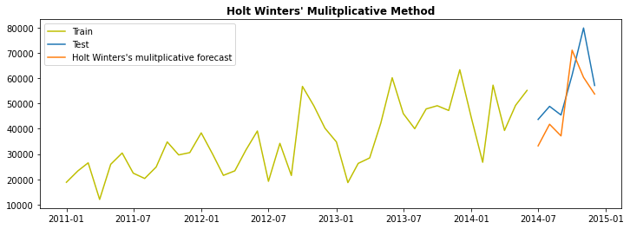
Holt’s Winter Multiplicative Time Series Model (HWM)
In this plot, the yellow line represents the training data, and the blue line represents the test data. The orange line represents the seasonality, trend, and level of the data, which is observed to be around the time period of approximately 2014 to 2015
This model seems to be predicting better but somewhat under predicting (still actual peak difference less than that of HWA) as do not reaches the actual peak
Note: HWM works better with large data points (>10) and aimed to predict all the 3 components i.e. level, trend, and seasonality

Slide 20

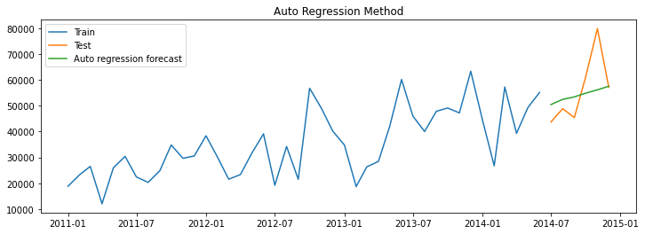
Auto Regressive Time Series Model (AR)
Model seems to forecast with trend and level of the data, and it is seen to bisect the test data set, indicating its reliability
The forecasted trend and level of the data are observed to be around the time period of approximately 2014 to 2015
Note: AR works better with large data points (>10) when there are only level and trend present in the data set.

Slide 21

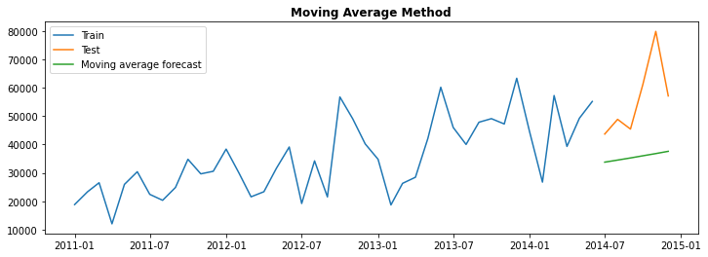
Moving Average Time Series Model (MAA) -- ARIMA
In this graph, the window size is only 1 month, and there is no seasonality observed. The data is seen to exhibit a trend and level pattern, with the blue line representing the training data and the orange line representing the test data. The green line shows the forecast of the data
Note: MAA works better with large data points (>10) when there are only level and trend present in the data set

Slide 22

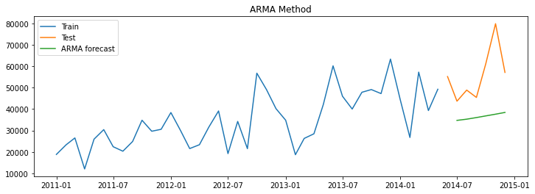
Auto Regressive Moving Average Time Series Model (ARMA)
Model is able to predict trend and level but is still under fitting and under predicting
Reason for Under Fitting can be:
Moving Average (MA) is being used in ARMA, which may not be suitable for large datasets with more than 10 data points
b) Model may not be capturing all the relevant information and could be missing important features or patterns in the data

Slide 23

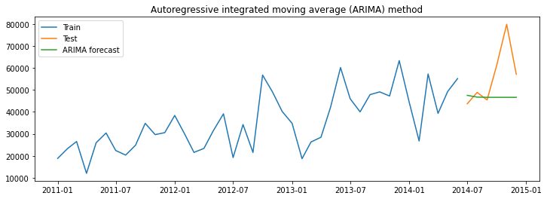
Auto Regressive Integrated Moving Average Time Series Model (ARIMA)
Model is predicting and fitting perfectly , but it has only found level and following trend
Note: ARIMA works better with large data points (>10) when there are only level and trend present in the data set

Slide 24

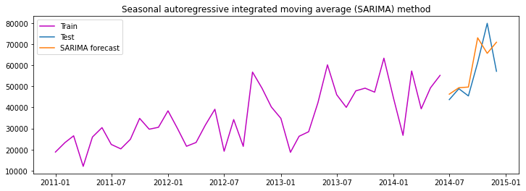
Seasonal Auto Regressive Integrated Moving Average Time Series Model (SARIMA)
Model is predicting and fitting good as it has found level, trend and seasonality in the data set
But it can is slightly under predicting as the actual peak could not be reached
Note: SARIMA works better with large data points (>10) when there are all 3 compenents: level, trend, and seasonality present in the data set

Slide 25
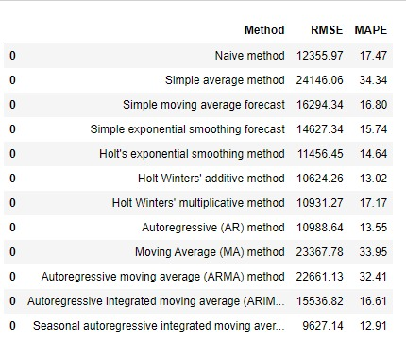
Finding the Reliable Time Series Model to further Go On with the Forecast
Holt-Winters additive (HWA) method is the most suitable technique for smoothing in forecasting
Among the ARIMA models, the Seasonal Autoregressive Integrated Moving Average (SARIMA) method is the most appropriate for forecasting
Note: Decision for Model Selection made on the low error values for HWA and SARIMA we got for RMSE and MAPE for them in comparison to others

Slide 26
Conclusion
APAC Consumer Market Segment seem to be the Highly Consistently Profitable Ones
SARIMA and Holt’s Winter Additive Method (HWA) both seems to predicting well all the 3 components: Level, Trend, and Seasonality in the dataset
Also SARIMA and HWA Model seems to be giving significantly less error values in forecasting when compared to other models

Slide 27
Recommendations for Inventory Management
Inventory to be Kept Well in Stock:
Since APAC Consumer Market Segment seem to be the Highly Consistently Profitable Ones, Items corresponding to these segments should be kept more in stock
Time Series Model Finalization:
SARIMA Time Series Model should be preferred over Holt’s Winter Additive Model as Error Values (Both RMSE and MAPE) in Sarima found to be lower than HWA’s corresponding Error Values

Slide 28
Appendix :
Data Source :
‘Global+Superstore+Data.csv’ contains all the information related to sales, profit, different markets and segments
Data Assumption
All the Transactions made or done has been assumed to be done in only 1 single currency i.e. US Dollar ($)

Slide 29
Appendix :
Data Preparation :
Checking for NA values in desired attributes
Found the Top - Most Consistently Highly Profitable segment as APAC-Consumer by calculating Co-efficient of variation
Creating 21 buckets for each of the seven markets and their corresponding three segments

Slide 30
Appendix :
Data Methodology :
Business And Data Understanding
Data Preparation
Segmentation of Data
Selecting Top Two Segments
Smoothening of Data
Conversion to Time Series
Segregating Test and Train Data
Model Evaluation
Model Designing

